Slide 1

21CSC202J OPERATING SYSTEMS UNIT – III
Course Learning Rationale (CLR):
CLR-3 Familiarize the scheduling algorithms, file systems, and I/O schemes:
Course Learning Outcomes (CLO):
CLO-3 :Exemplify different types of scheduling algorithms and deadlock mechanism.

Slide 2
TOPICS COVERED
CPU SCHEDULING :
FCFS,SJF, Priority scheduling, Round robin, Multilevel queue Scheduling, Multilevel feedback Scheduling.
REAL TIME SCHEDULING:
Rate Monotonic Scheduling and Deadline Scheduling
DEADLOCKS:
Necessary conditions, Resource allocation graph, Deadlock prevention methods, Deadlock Avoidance, Detection and Recovery

Slide 3

PROCESS SCHEDULING

Slide 4
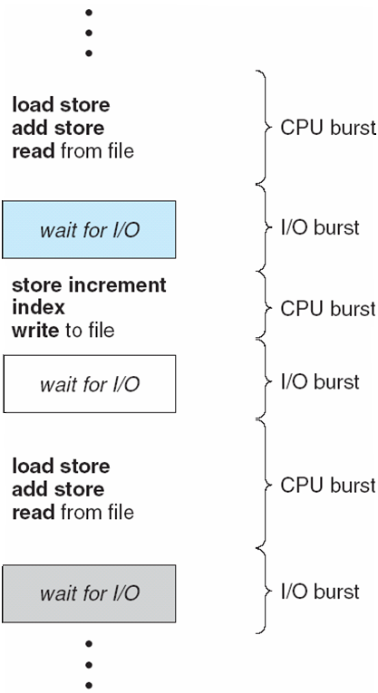
Basic Concepts
Maximum CPU utilization is obtained with multiprogramming
Process execution consists of a cycle of a CPU time burst and an I/O time burst
Processes alternate between these two states (i.e., CPU burst and I/O burst)
Eventually, the final CPU burst ends with terminate execution

Slide 5
Preemptive:
The CPU is allocated to the process, if any higher priority process come it releases the CPU and get the service once the higher priority process completes.
Non Preemptive:
Once the CPU is allocated to the process, the process keeps the CPU until it releases the CPU either by terminating or switching to waiting state.

Slide 6
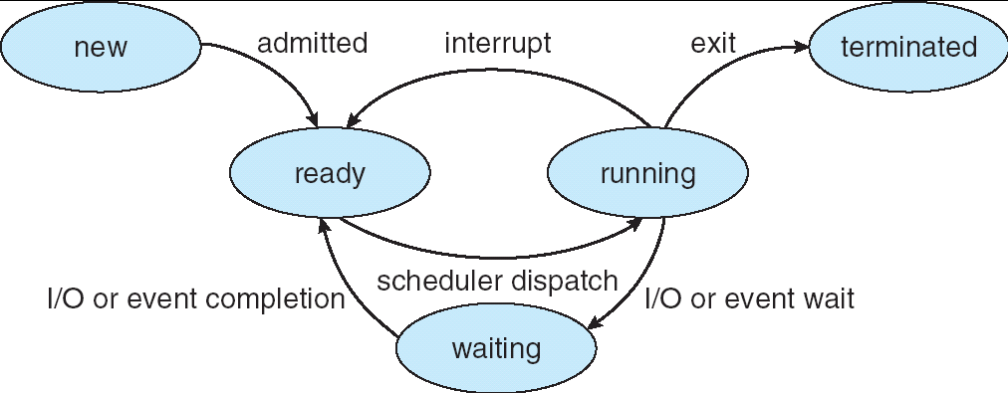
CPU Scheduler
The CPU scheduler selects from among the processes in memory that are ready to execute and allocates the CPU to one of them
Ready Queue 🡪 CPU
When CPU scheduling takes place?
1. (N) A process switches from running to waiting state
2. (P) A process switches from running to ready state
3. (P) A process switches from waiting to ready state
4. (N) A processes switches from running to terminated state
Circumstances 1 and 4 are non-preemptive
Circumstances 2 and 3 are pre-emptive

Slide 7
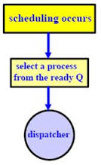
Dispatcher
The dispatcher module gives control of the CPU to the process selected by the short-term scheduler; this involves:
switching context
switching to user mode
jumping to the proper location in the user program to restart that program
The time it takes for the dispatcher to stop one process and start another process is called dispatch latency

Slide 8
Scheduling Criteria
Different CPU scheduling algorithms have different properties
CPU utilization – keep CPU as busy as possible
CPU utilization ranges from 0% to 100%
Lightly loaded system 🡪 40%
Heavily loaded system 🡪 90%
Throughput = Number of processes completed /Unit time
Response time – amount of time it takes from when a request was submitted until the first response occurs
Waiting time – the amount of time the processes has been waiting in the ready queue
Turnaround time – amount of time to execute a particular process from the time of submission through the time of completion

Slide 9
Scheduling Algorithms
First-Come, First-Served (FCFS) Scheduling
Shortest-Job-First (SJF) Scheduling
Simultaneous arrival times
Varied arrival times
Preemptive SJF with varied arrival times = Shortest-remaining time First (SRT) Scheduling
Priority Scheduling
Preemptive & non preemptive
Round robin scheduling
Multi-level Queue Scheduling
Multilevel Feedback Queue Scheduling

Slide 10
First-Come, First-Served (FCFS) Scheduling
The first entered job is the first one to be serviced.
Example: Three processes arrive in order P1, P2, P3.
P1 burst time: 24
P2 burst time: 3
P3 burst time: 3
Draw the Gantt Chart and compute Average Waiting Time and Average Completion Time.

Slide 11
First-Come, First-Served (FCFS)
Example: Three processes arrive in order P1, P2, P3.
P1 burst time: 24
P2 burst time: 3
P3 burst time: 3
Waiting Time
P1: 0
P2: 24
P3: 27
Completion Time
P1: 24
P2: 27
P3: 30
Average Waiting Time: (0+24+27)/3 = 17
Average Turnaround time: (24+27+30)/3 =27
Convoy effect (2 mark)
All the other processes wait for one long process to finish its execution
P1
P2
P3
0
24
27
30

Slide 12
First-Come, First-Served (FCFS)
What if their order had been P2, P3, P1?
P1 burst time: 24
P2 burst time: 3
P3 burst time: 3

Slide 13
First-Come, First-Served (FCFS)
What if their order had been P2, P3, P1?
P1 burst time: 24
P2 burst time: 3
P3 burst time: 3
Waiting Time
P2: 0
P3: 3
P1: 6
Turn-around Time
P2: 3
P3: 6
P1: 30
Average Waiting Time: (0+3+6)/3 = 3 (compared to 17)
Average turn-around Time: (3+6+30)/3 = 13 (compared to 27)
P2
P3
P1
0
3
6
30
Gnatt Chart

Slide 14
FIFO (First In and First Out) or FCFS
Advantages:
Simple
Disadvantages:
Short jobs get stuck behind long ones
There is no option for pre-emption of a process. If a process is started, then CPU executes the process until it ends.
Because there is no pre-emption, if a process executes for a long time, the processes in the back of the queue will have to wait for a long time before they get a chance to be executed.

Slide 15
Shortest-Job-First (SJF) Scheduling (simultaneous arrival ie. all jobs arrive at the same time)
Example 1
P1 burst time: 24
P2 burst time: 3
P3 burst time: 3
Waiting Time
P2: 0
P3: 3
P1: 6
Turn-around Time
P2: 3
P3: 6
P1: 30
Average Waiting Time: (0+3+6)/3 = 3
Average turn-around Time: (3+6+30)/3 = 13
P2
P3
P1
0
3
6
30
Gnatt Chart

Slide 16
Shortest-Job-First (SJF) Scheduling Here come the concept of arrival time. SJF (non-preemptive, varied arrival times)
Example 2
Process Arrival Time Burst Time
P₁ 0 7
P₂ 2 4
P₃ 4 1
P₄ 5 4
Average waiting time = ( (0 – 0) + (8 – 2) + (7 – 4) + (12 – 5) )/4 = (0 + 6 + 3 + 7)/4 = 4
Average turn-around time: = ( (7 – 0) + (12 – 2) + (8 - 4) + (16 – 5))/4 = ( 7 + 10 + 4 + 11)/4 = 8
Gnatt Chart
P₁
P₃
P₂
P₄
0
3
7
8
12
16
Waiting time : sum of time that a process has spent waiting in the ready queue

Slide 17
Shortest-remaining time First (SRT) Scheduling Preemptive SJF with varied arrival times
Example 3
Process Arrival Time Burst Time
P₁ 0.0 7
P₂ 2.0 4
P₃ 4.0 1
P₄ 5.0 4
Average waiting time
= ( [(0 – 0) + (11 - 2)] + [(2 – 2) + (5 – 4)] + (4 - 4) +
(7 – 5) )/4 = 9 + 1 + 0 + 2)/4
= 3
Average turn-around time = (16-0) + (7-2) + (5-4) + (11-5))/4 = 7
P₁
P₂
P₃
P₂
P₄
P₁
Gnatt Chart
0
2
4
5
7
11
16

Slide 18
Shortest-Job-First (SJF) Scheduling Pros and Cons
Advantages:
Works based on the next process CPU burst
It gives optimal waiting time
Disadvantages:
Long jobs get stuck behind short ones

Slide 19
Priority Scheduling
A priority number (integer) is associated with each process
The CPU is allocated to the process with the highest priority (smallest integer ≡ highest priority)
Preemptive
Nonpreemptive
SJF is priority scheduling where priority is the inverse of predicted next CPU burst time
Problem ≡ Starvation – low priority processes may never execute
Solution ≡ Aging – as time progresses increase the priority of the process

Slide 20
Priority Scheduling (Non- Preemptive)
A priority number (integer) is associated with each process
(smallest integer = highest priority)
Process
A
B
C
Burst Time
8
1
1
Priority
2
1
3
B
A
C
0
1
9
10
Gnatt Chart
Avg Wait Time (0 + 1 + 9) / 3 = 3.3

Slide 21
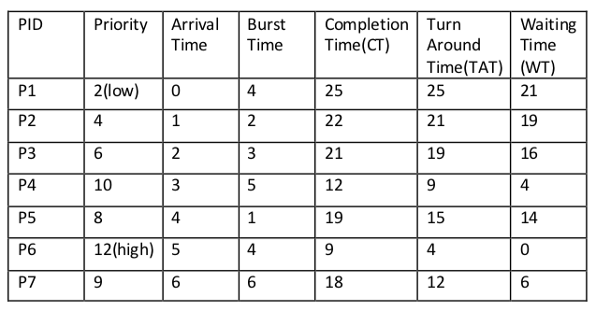
Priority Scheduling (Preemptive)
Consider the example with seven process.

Slide 22
Gantt chart
Average waiting time
Starvation
It is a situation in which the continuous arrival of higher priority process keeps the lowest priority process always in waiting state. The waiting process will starve (in other words, the deadline of the waiting process will never meet). We can resolve the starvation problem in the priority scheduling with the help of Aging technique.
Aging Technique
In Aging technique, the priority of every lower priority processes has to be increased after a fixed interval of time.

Slide 23
Priority Scheduling Pros and Cons
Advantages:
Higher priority job executes first
Disadvantages:
Starvation ie. low priority processes never execute.
To overcome the above problem “AGING” 🡪 the priority of a process is increased

Slide 24
Round Robin (RR) Scheduling
In the round robin algorithm, each process gets a small unit of CPU time (a time quantum), usually 10-100 ms.
After this time has elapsed, the process is preempted and added to the end of the ready queue.
Performance of the round robin algorithm
q large ⇒ FCFS
q small ⇒ q must be greater than the context switch time; otherwise, the overhead is too high

Slide 25
Example of RR with Time Quantum = 4
Example 1
Process Burst Time
P₁ 24
P₂ 3
P₃ 3
The Gantt chart is:
P₁
P₂
P₃
P₁
P₁
P₁
P₁
P₁
0
4
7
10
14
18
22
26
30
Average turn around time is larger than SJF
But more context switching
Average waiting time =(6+4+7)/3 = 5.6 ms

Slide 26
Example of RR with Time Quantum = 20
Process Burst Time
P₁ 53
P₂ 17
P₃ 68
P₄ 24
Gantt chart is:
Average waiting time = ( [(0 – 0) + (77 - 20) + (121 – 97)] + (20 – 0) + [(37 – 0) + (97 - 57) +
(134 – 117)] + [(57 – 0) + (117 – 77)] ) / 4 = (0 + 57 + 24) + 20 + (37 + 40 + 17) + (57 + 40) ) / 4 = (81 + 20 + 94 + 97)/4 = 292 / 4 = 73
Average turn-around time = (134 + 37 + 162 + 121) / 4 = 113.5
Example 2
P₁
P₂
P₃
P₄
P₁
P₃
P₄
P₁
P₃
P₃
0
20
37
57
77
97
117
121
134
154
162

Slide 27
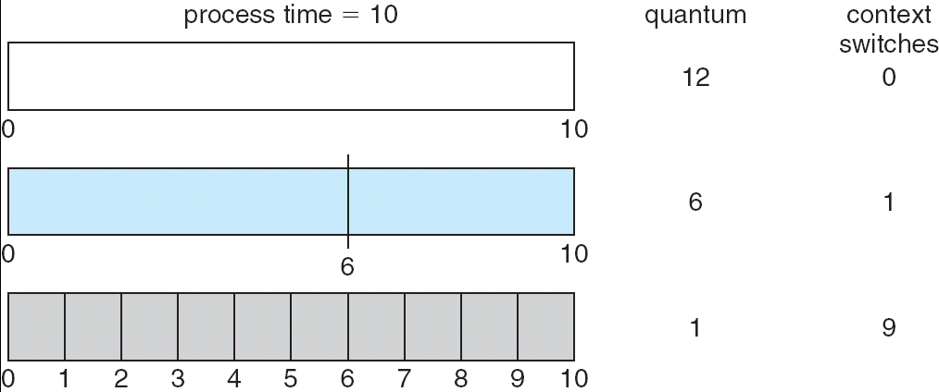
Time Quantum and Context Switches

Slide 28
Round Robin (RR) Scheduling Pros and Cons
Advantages:
Fair for smaller tasks
Disadvantages:
More context switching

Slide 29
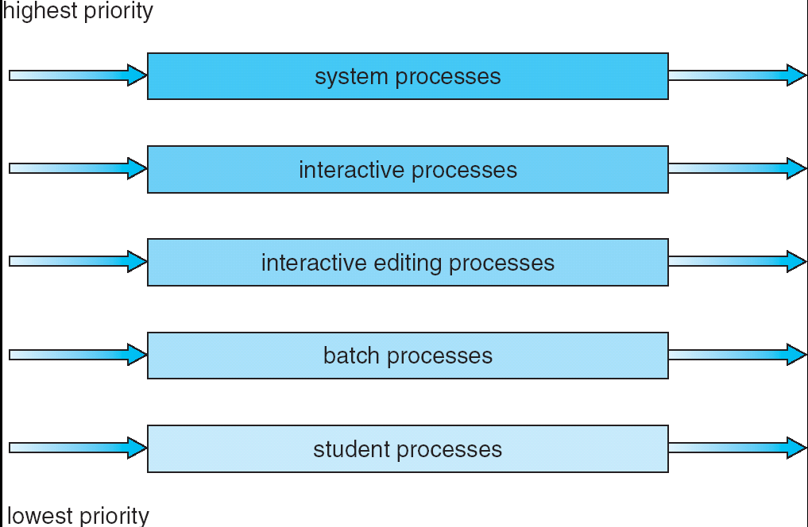
Multi-level Queue Scheduling
Multi-level queue scheduling is used when processes can be classified into groups
For example, foreground (interactive) processes and background (batch) processes
80% of the CPU time to foreground queue using RR.
20% of the CPU time to background queue using FCFS

Slide 30
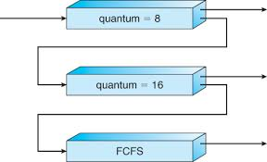
Multilevel Feedback Queue Scheduling
In multi-level feedback queue scheduling, a process can move between the various queues;
A new job enters queue Q₀ (RR) and is placed at the end. When it gains the CPU, the job receives 8 milliseconds. If it does not finish in 8 milliseconds, the job is moved to the end of queue Q₁.
A Q₁ (RR) job receives 16 milliseconds. If it still does not complete, it is preempted and moved to queue Q₂ (FCFS).
Q₀
Q₁
Q₂

Slide 31
Real-Time CPU Scheduling
CPU scheduling for real-time operating systems involves special issues.
In general, we can distinguish between soft real-time systems and hard real-time systems.
Soft real-time systems provide no guarantee as to when a critical real-time process will be scheduled. They guarantee only that the process will be given preference over noncritical processes.
Hard real-time systems have stricter requirements. A task must be serviced by its deadline; service after the deadline has expired is the same as no service at all.
In this section, we explore several issues related to process scheduling in both soft and hard real-time operating systems

Slide 32
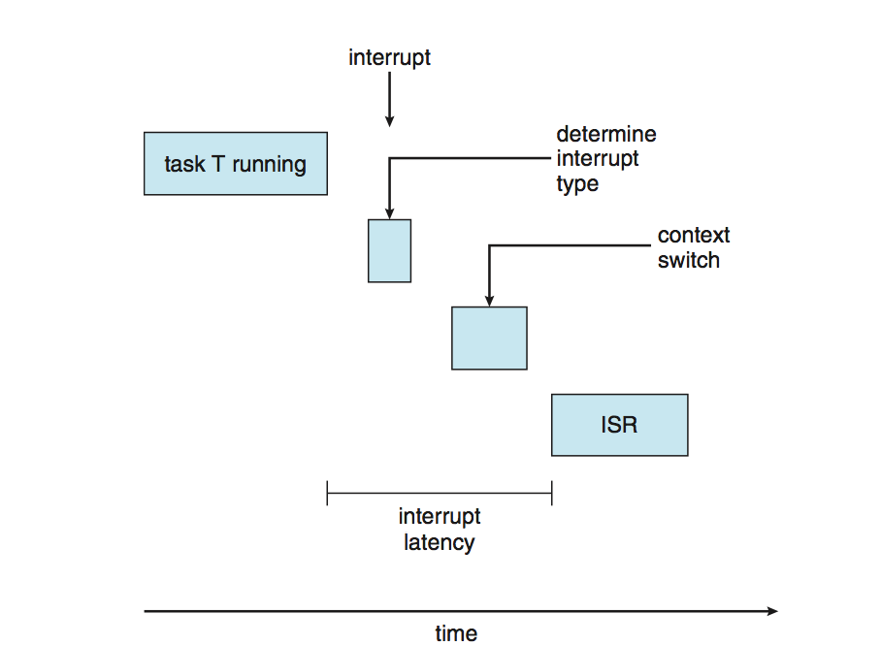
Real-Time CPU Scheduling
Two types of latencies affect performance
Interrupt latency – time from arrival of interrupt to start of routine that services interrupt
Dispatch latency – time for schedule to take current process off CPU and switch to another

Slide 33
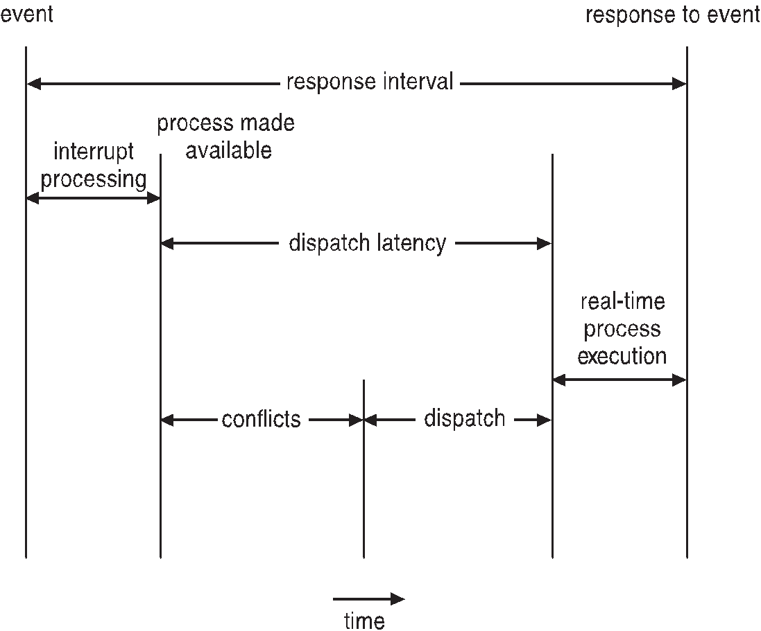
Real-Time CPU Scheduling (Cont.)
Conflict phase of dispatch latency:
Preemption of any process running in kernel mode
Release by low-priority process of resources needed by high-priority processes

Slide 34
Priority-based Scheduling
The most important feature of a real-time operating system is to respond immediately to a real-time process as soon as that process requires the CPU.
As a result the scheduler for a real-time operating system must support a priority-based algorithm with preemption.
Recall that priority-based scheduling algorithm assign each process a priority based on its importance; more are assigned higher priorities than those deemed less important.
If the scheduler also supports preemption, a process currently running on the CPU will preempted if a higher-priority process becomes available to run.

Slide 35
Priority-based Scheduling
Before we proceed with the details of the individual schedulers, how we must define certain characteristics of the processes that are to be scheduled.
Periodic processes require the CPU at specified intervals (periods).
p is the duration of the period.
d is the deadline by when the process must be serviced.
t is the processing time.
The relationship of the processing time, the deadline, and the period can be expressed as 0 ≤ t ≤ d ≤ p.

Slide 36
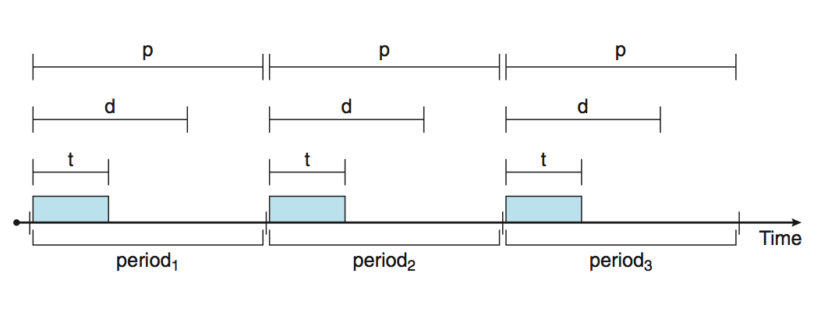
Priority-based Scheduling

Slide 37
Rate Monotonic Scheduling
The rate-monotonic scheduling algorithm schedules periodic tasks using static priority policy with preemption.
If a lower-priority process is running and a higher-priority process becomes available to run, it will preempt the lower priority process.
Upon entering the system, each periodic tasks and Priority inversely based on its period.
Shorter periods = higher priority;
Longer periods = lower priority
The rationale behind this policy is to assign a higher priority to tasks that require the CPU more often.
Furthermore, rate-monotonic scheduling assumes that the processing time of A periodic process is the same for each CPU burst. That is, every time a process acquires the CPU, the duration of its CPU burst is the same

Slide 38
Rate Monotonic Scheduling
Let's consider an example. We have two processes, P1 and P2.
The periods for P1 and P2 are p1=50, p2=100. The processing times are t1=20, t2=35.
The deadline for each it complete its CPU burst by the start of its next period.
We must ask ourselves whether it is possible to schedule these tasks so that each meets its deadlines.
If we measure the CPU utilization of a process Pi as the ratio of its burst to its period ti/pi.
The CPU utilization of P1 is 20/50=0.40 and that P2 is 35/100 = 0.35, for a total CPU utilization of 75percent.
Therefore, it seems we can schedule these tasks in such a way that both meet their deadlines and still leave the CPU with available cycles.

Slide 39
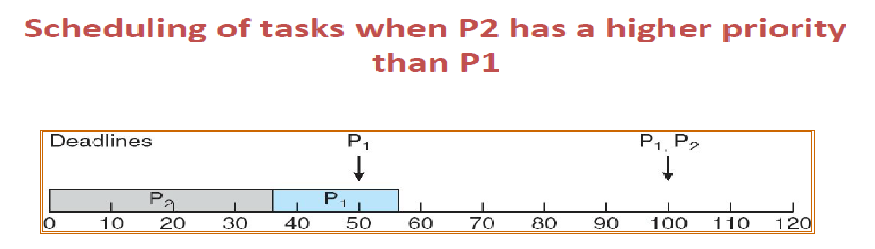
Rate Monotonic Scheduling
Example(Why not Priority scheduling)
Suppose we assign P2 a higher priority than P1.
The execution of P1 and P2 in this situation is shown in the below Figure.
As we can see, P2 starts execution first and completes at time 35.
At this point, P1 starts; it completes its CPU burst at time 55.
However, the first deadline for P1 was at time 50, so the scheduler has caused P1 to miss its deadline.

Slide 40
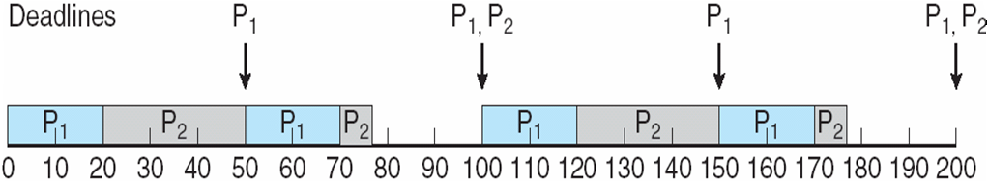
Rate Monotonic Scheduling
Now suppose we use rate-monotonic scheduling, in which we assign P1 a higher priority than P2 because the period of P1 is shorter than that of P2.
The execution of these processes in this situation is shown in the below Figure.
P1 starts first and completes its CPU burst at time 20, thereby meeting its first deadline.
P2 starts running at this point and runs until time 50.
At this time, it is preempted by P1, although it still has 5 milliseconds remaining in its CPU burst.
P1 completes its CPU burst at time 70, at which point the scheduler resumes P2.

Slide 41
Missed Deadlines with Rate Monotonic Scheduling
Let's next examine a set of processes that cannot be scheduled using the rate Monotonic algorithm.
Assume that process P1 has a period of p1 = 50 and a CPU burst of t1=25.
For P2, the corresponding values are p2= 80 and t2= 35.
Rate-monotonic scheduling would assign process P1 a higher priority as it has the shorter period.
The total CPU utilization of the two processes is (25/50)+(35/80)=0.94, and it therefore seems logical that the two processes could be scheduled an leave the CPU with 6 percent available time.

Slide 42
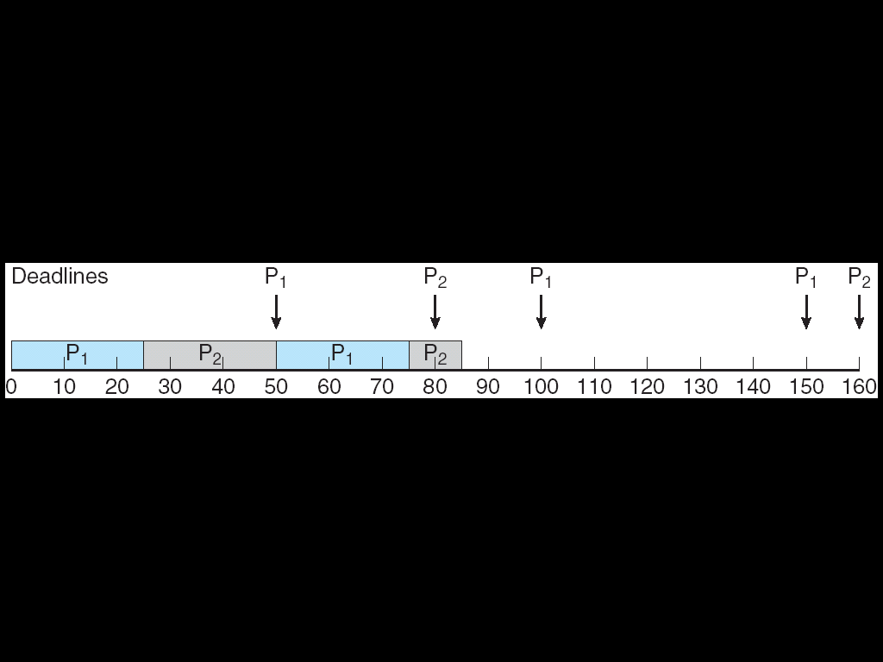
Missed Deadlines with Rate Monotonic Scheduling
Below figure shows the scheduling processes P1 and P2. Initially P1, runs until it completes its CPU burst at time 25.
Process P2 then begins running and runs until time 50, when it is preempted by P1.
At this point, P2, still has 10 milliseconds remaining in its CPU burst. Process P1 runs until time 75; consequently, P2 finishes its burst at time 85, after the deadline for completion of its CPU burst at time 80.
p1=50, p2=80 t1=25, t2=35

Slide 43
Earliest Deadline First Scheduling (EDF)
Earliest-deadline-first (EDF) scheduling dynamically assigns priorities according to deadline.
The earlier the deadline, the higher the priority; the later the deadline, the lower the priority.
Under the EDF policy, when a process becomes runnable, it must announce its deadline requirements to the system. Priorities may have to be adjusted to reflect the deadline of the newly runnable process.
Note how this differs from rate-monotonic scheduling, where priorities are fixed.
To illustrate EDF scheduling, we again schedule the processes which failed to meet deadline requirement under the rate-monotonic scheduling.

Slide 44
Earliest Deadline First Scheduling (EDF)
Recall that P1 has values of p1=50 and t1=25 and that values of p2 = 80 and t2= 35.
The EDF scheduling of these processes in below figure. Process P1 has the earliest deadline, so its initial priority is higher than that of process P2.
Process P2 begins running at the end of the CPU burst for P1. However, whereas rate-monotonic scheduling allows P1 to preempt P2 at the beginning of its next period at time 50, EDF scheduling allows process P2 to continue running.
P2 now has a higher priority than P1, because its next deadline (at time 80) is earlier than that of P1 (at time 100).
Thus, both P1 and P2 meet their first deadlines. Process P1 again begins running, at time 60 and completes its second CPU burst at time 85, also meeting its second deadline at time 100.
P2 begins running at this point, only to be preempted by P1 at the start of its next period at time 100. P2 is preempted because P1 has an earlier deadline (time 150) than P2(time 160).
At time 125, P1 completes its CPU burst and P2 resumes execution, finishing at time 145 and meeting its deadline a well.
The system is idle until time 150, when P1 is scheduled to run once again.

Slide 45
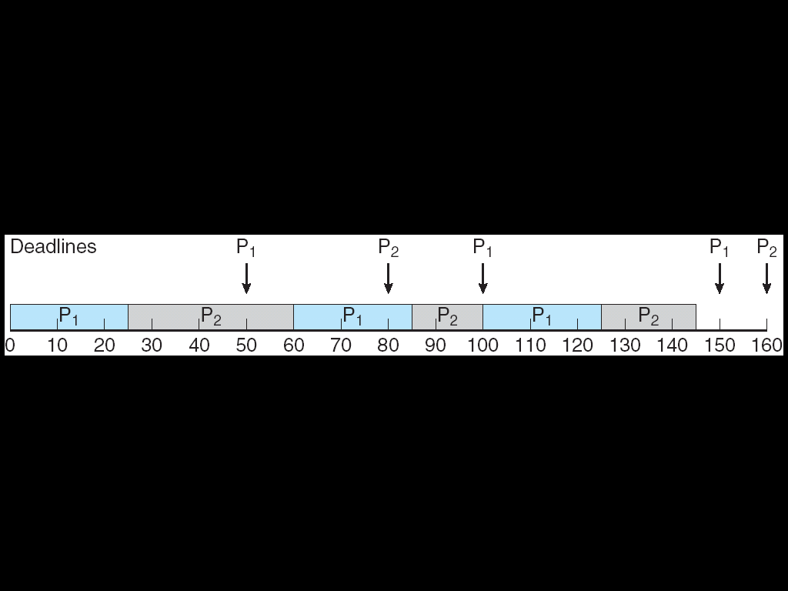
Earliest Deadline First Scheduling (EDF)
Unlike the rate-monotonic algorithm, EDF scheduling does not require that processes be periodic, nor must a process require a constant amount of CPU time per burst.
The only requirement is that a process announce its deadline to the scheduler when it becomes runnable.
The appeal of EDF scheduling is that it is theoretically optimal -- theoretically, it can schedule processes so that each process can meet its deadline requirements and CPU utilization will be 100 percent.
In practice, however, it is impossible to achieve this level of CPU utilization due to the cost of context switching between processes and interrupt handling.

Slide 46
Deadlocks

Slide 47
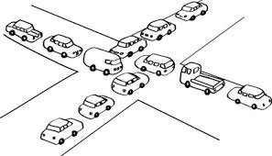
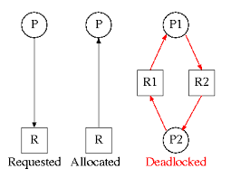
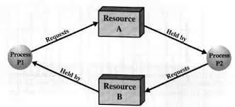
Deadlocks
Assume 2 process, P1 and p2.
When p1 process is holding resource R1 and requesting for resource R2, where it is hold by process P2. This state is DEADLOCK.

Slide 48
System Model
Assume resource types R₁, R₂, . . ., R_{m}
CPU cycles, memory space, I/O devices
Each resource type R_{i} has 1 or more instances
Each process utilizes a resource as follows:
Request
The process requests the resource.
If (resource == available)
Grant the resource
else
Wait
Use
The process use the resource
Release
The process release the resource

Slide 49
Deadlock Characterization Repeated University Question
Deadlock can arise if four conditions hold simultaneously.
Mutual exclusion:
Only one process at a time can use a resource. If another process requests, they need to wait.
Hold and wait:
A process holding at least one resource is waiting to acquire additional resources which is held by other processes
No preemption:
A resource can be released only voluntarily by the process holding it after that process has completed its task
Circular wait:
There exists a set {P₀, P₁, …, P₀} of waiting processes
P₀ is waiting for a resource that is held by P₁
P₁ is waiting for a resource that is held by P₂
P_{n–1} is waiting for a resource that is held by P_{n}
P_{n} is waiting for a resource that is held by P₀
P₀
P₁
P_{n-1}
P_{n}

Slide 50
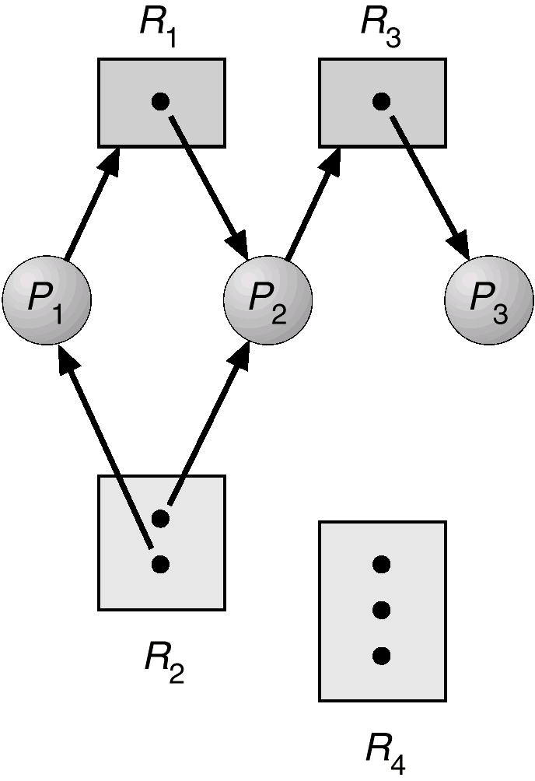
Resource-Allocation Graph
Deadlocks are described in terms of directed graph called Resource Allocation Graph.
Graph consists of a set of vertices V and a set of edges E.
Request edge:
It is a directed edge from P₁ to resource type R_{j}
P₁ → R_{j}
Assignment edge:
It is a directed edge from R_{j}
to resource type P₁
R_{j} → P₁
R3 Assigned to P3
P2 Requests R3
Note:
If resource type has more than 1 instance, its indicated by a dot within the rectangle.

Slide 51
Details
The resource allocation graph consists of following sets:
P ={ P1,P2,p3}
R ={ R1, R2, R3, R4}
E = { p1 🡪 R1, P2 🡪 R3, R1 🡪 P2,
R2🡪 P2, R2🡪P1, R3🡪 P3}
P = Process; R = Resources; E = Edges.
Resource Instance
One instance of resource type R1
Two instance of resource type R2
One instance of resource type R3
Three instance of resource type R4

Slide 52
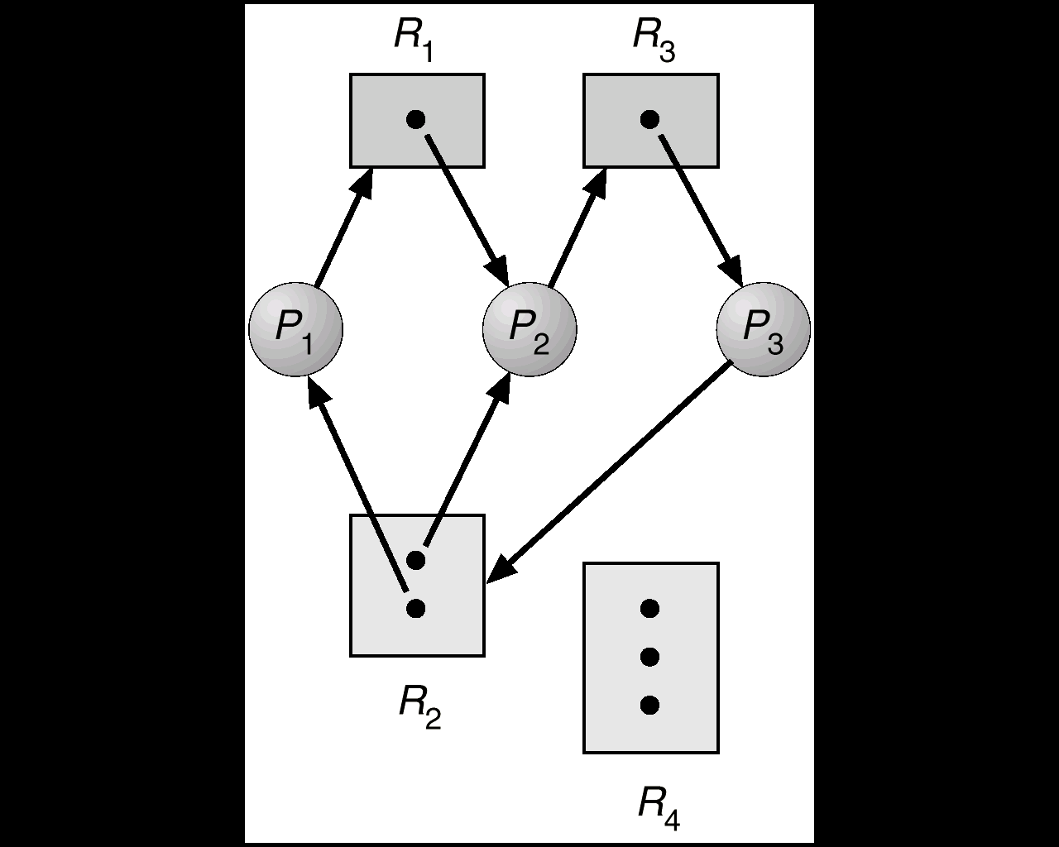
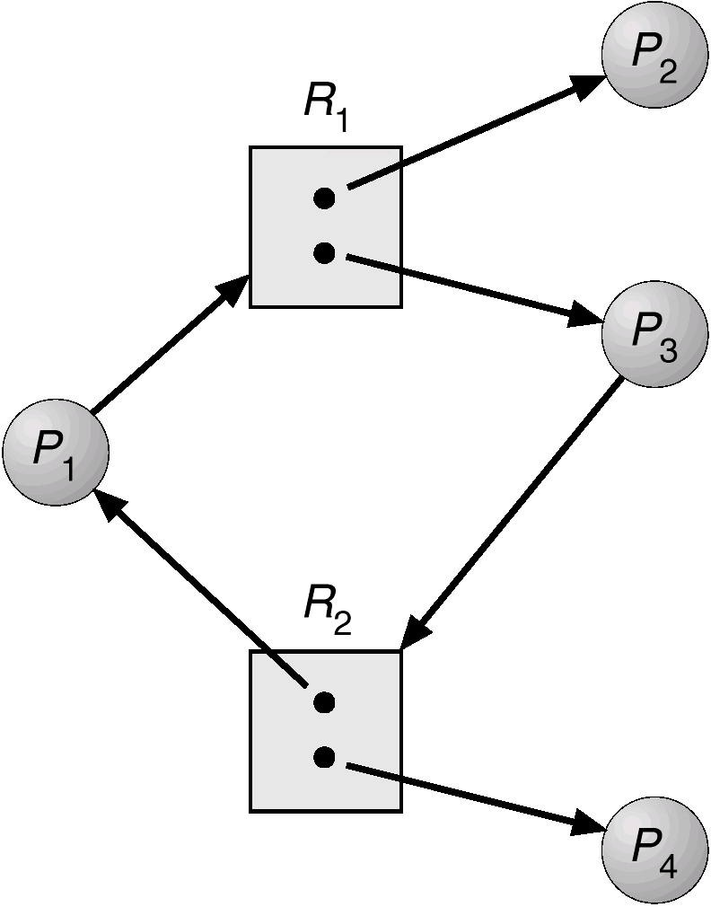
Examples
Resource allocation graph
with a deadlock.
Resource allocation graph
with a cycle but no deadlock.

Slide 53
HOW TO HANDLE DEADLOCKS ? (or)
Methods for handling deadlocks.
There are three methods:
Ignore Deadlocks:
Ensure deadlock never occurs using either
Prevention :
Prevent any one of the 4 conditions never happens.
Avoidance :
Allow all deadlock conditions, but calculate cycles and stop dangerous operations..
Allow deadlock to happen. This requires using both:
Detection Know a deadlock has occurred.
Recovery Regain the resources.
1
Most Operating systems do this!!
2
3

Slide 54
Deadlock Prevention
Do not allow one of the four conditions to occur.
Mutual exclusion:
Read only files are good examples for sharable resource
Any number of users can access the file at the same time.
Prevention not possible, since some devices like are non-sharable.
Hold and wait:
Collect all resources before execution
A sequence of resources is always collected at the beginning itself.
Utilization is low, starvation possible.

Slide 55
Deadlock Prevention – Contd…
No preemption:
If the process is holding some resources and requests another resource (that cannot be immediately allocated to it), then all the resources that the process currently holding are preempted.
Circular wait:
R = { R1,R2…Rm} 🡪 set all resource types.
We define a function,
For example: F(tape drive) = 1 F(disk drive) = 5 F(printer) = 12
Each process requests resources in an increasing order of enumeration (ie) F(R_{j}) > F(R_{i})
F: R 🡪 N
N = natural number

Slide 56
Deadlock Avoidance
When we try to avoid deadlock
Utilization is less and system throughput is low
An alternative method for avoiding deadlocks is to require additional information about how much resources are to be requested.

Slide 57
Safe State
NOTE: All deadlocks are unsafe, but all unsafes are NOT deadlocks.
SAFE
UNSAFE
DEADLOCK
Only with luck, the processes avoid deadlock.
OS can avoid
deadlock.

Slide 58
Safe State
A system is said to be in safe state, when we allocate resources so that deadlock never occurs.
A system is in safe state, only if there exists safe sequence.

Slide 59
Deadlock Avoidance - Example
EXAMPLE:
There exists a total of 12 resources and 3 processes.
Process | Max Needs | Allocated | Current Needs
P0 | 10 | 5 | 5
P1 | 4 | 2 | 2
P2 | 7 | 3 | 4
At time t0 , system is in safe state
At time t1, < p1, p2, p0 > is a safe sequence.
Suppose p2 requests and is given one more resource. What happens then?

Slide 60
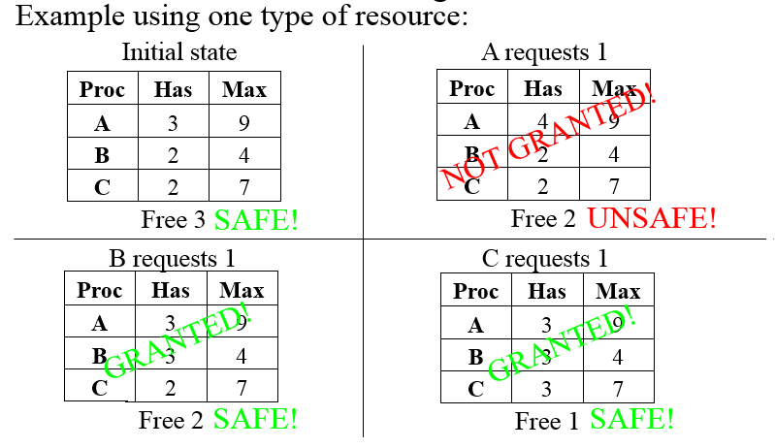
Examples

Slide 61
Avoidance algorithms
For a single instance of a resource type, use a Resource-allocation Graph
For multiple instances of a resource type, use the Banker’s Algorithm

Slide 62
Resource-Allocation Graph
Introduce a new kind of edge called a Claim Edge Claim edge P_{i} R_{j} indicates that process P_{i} may request resource R_{j}; which is represented by a dashed line.
A claim edge converts to a request edge when a process requests a resource
A request edge converts to an assignment edge when the resource is allocated to the process
When a resource is released by a process, an assignment edge reconverts to a claim edge.
Claim Edge
Can be converted to
Request Edge
Can be converted to
Assignment Edge
Can be converted to

Slide 63
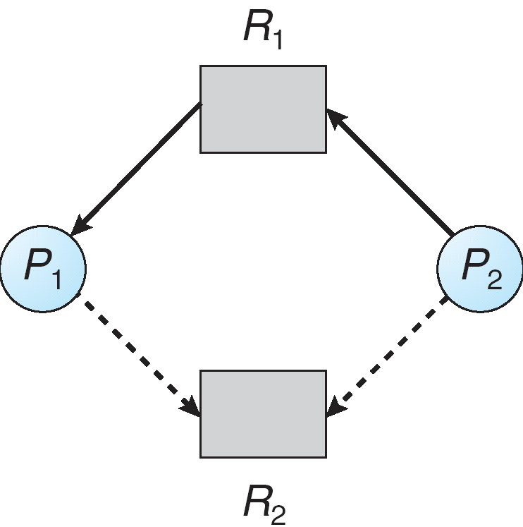
Resource-Allocation Graph with Claim Edges
Unsafe State In Resource-Allocation Graph
Assignment
edge
Request
edge
Claim
edge
Claim
edge
Assignment
edge
Request
edge
Claim
edge
Assignment
edge

Slide 64
Banker’s Algorithm
Applicable for multiple instances of a resource type.
Its less efficient than Resource-Allocation Graph
When a process requests a resource, the system determines whether the allocation of resources will lead to safe state.
If it lead to safe state 🡪 allocate resources
If not safe state 🡪 don’t allocate resources

Slide 65
Data Structures for the Banker’s Algorithm
Let n = number of processes, and m = number of resources types.
Available: Vector of length m. If Available [j] = k, there are k instances of resource type R_{j} available.
Max: n x m matrix. If Max [i,j] = k, then process P_{i} may request at most k instances of resource type R_{j}.
Allocation: n x m matrix. If Allocation[i,j] = k then P_{i} is currently allocated k instances of R_{j.}
Need: n x m matrix. If Need[i,j] = k, then P_{i} may need k more instances of R_{j} to complete its task.
Need [i,j] = Max[i,j] – Allocation [i,j]

Slide 66
Safety Algorithm
1.Let Work and Finish be vectors of length m and n, respectively. Initialize:
Work = Available
Finish [i] = false for i = 0, 1, …, n- 1
2.Find an i such that both:
(a) Finish [i] = false
(b) Need_{i} ≤ Work
If no such i exists, go to step 4
3.Work = Work + Allocation_{i} Finish[i] = true go to step 2
4.If Finish [i] == true for all i, then the system is in a safe state

Slide 67
Resource-Request Algorithm for Process P_{i}
Request = request vector for process P_{i}.
If Request_{i} [j] = k then process P_{i} wants k instances of resource type R_{j}
1. If Request_{i} ≤ Need_{i} go to step 2.
Otherwise error.
2. If Request_{i} ≤ Available, go to step 3.
Otherwise P_{i} must wait, since resources are not
available
3. Assume that resources are allocated:
Available = Available – Request;
Allocation_{i} = Allocation_{i} + Request_{i};
Need_{i} = Need_{i} – Request_{i};

Slide 68
Example of Banker’s Algorithm
5 processes P₀ through P₄;
3 resource types:
A (10 instances), B (5 instances), C (7 instances)
Snapshot at time T₀:
Allocation Max Available
A B C A B C A B C
P₀ 0 1 0 7 5 3 3 3 2
P₁ 2 0 0 3 2 2
P₂ 3 0 2 9 0 2
P₃ 2 1 1 2 2 2
P₄ 0 0 2 4 3 3

Slide 69
Example (Cont.)
The content of the matrix Need is defined to be Need = Max – Allocation
Need
A B C
P₀ 7 4 3
P₁ 1 2 2
P₂ 6 0 0
P₃ 0 1 1
P₄ 4 3 1
The system is in a safe state since the sequence < P₁, P₃, P₄, P₀, P₂> satisfies safety criteria

Slide 70
Example: P₁ Request (1,0,2)
Check that Request ≤ Available (ie, (1,0,2) ≤ (3,3,2) ⇒ true
Allocation Need Available
A B C A B C A B C
P₀ 0 1 0 7 4 3 2 3 0
P₁ 3 0 2 0 2 0
P₂ 3 0 2 6 0 0
P₃ 2 1 1 0 1 1
P₄ 0 0 2 4 3 1
Executing safety algorithm shows that sequence
< P₁, P₃, P₄, P₀, P₂> satisfies safety requirement.
Can request for (3,3,0) by P₄ be granted?
Can request for (0,2,0) by P₀ be granted?

Slide 71
Deadlock Detection
Allow system to enter deadlock state
Detection algorithm
Recovery scheme

Slide 72
Single Instance of Each Resource Type
Maintain wait-for graph
Nodes are processes
P_{i} → P_{j} if P_{i} is waiting for P_{j}
Periodically invoke an algorithm that searches for a cycle in the graph. If there is a cycle, there exists a deadlock.
An algorithm to detect a cycle in a graph requires an order of n² operations, where n is the number of vertices in the graph

Slide 73
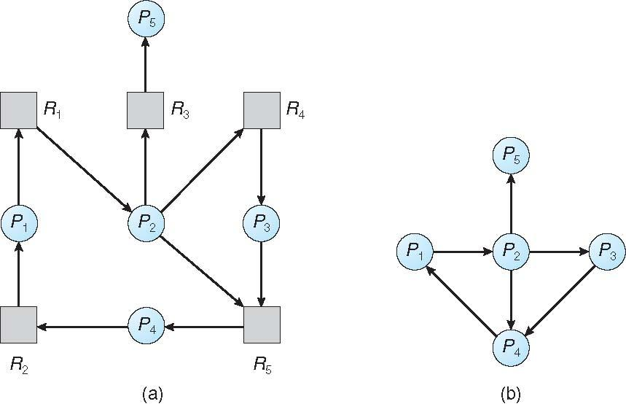
Resource-Allocation Graph and Wait-for Graph
Resource-Allocation Graph
Corresponding
wait-for graph

Slide 74
Several Instances of a Resource Type
Available: A vector of length m indicates the number of available resources of each type.
Allocation: An n x m matrix defines the number of resources currently allocated.
Request: An n x m matrix indicates the current request of each process. If Request [i][j] = k, then process P_{i} is requesting k more instances of resource type R_{j}.

Slide 75
Detection Algorithm
1.Let Work and Finish be vectors of length m and n, respectively
(a) Work = Available
(b) For i = 1,2, …, n, if Allocation_{i} ≠ 0, then Finish[i] = false;
otherwise, Finish[i] = true
2. Find an index i such that both:
(a) Finish[i] == false
(b) Request_{i} ≤ Work
If no such i exists, go to step 4
3. Work = Work + Allocation_{i} Finish[i] = true go to step 2
4. If Finish[i] == false, for some i, 1 ≤ i ≤ n, then the system is in deadlock state. Moreover, P_{i} is also deadlocked

Slide 76
Example of Detection Algorithm
Five processes P₀ through P₄;
three resource types A (7 instances), B (2 instances), and C (6 instances)
Snapshot at time T₀:
Allocation Request Available
A B C A B C A B C
P₀ 0 1 0 0 0 0 0 0 0
P₁ 2 0 0 2 0 2
P₂ 3 0 3 0 0 0
P₃ 2 1 1 1 0 0
P₄ 0 0 2 0 0 2
Sequence <P₀, P₂, P₃, P₁, P₄> will result in
Finish[i] = true for all i
No Deadlock

Slide 77
Example (Cont.)
P₂ requests an additional instance of type C
Request
A B C
P₀ 0 0 0
P₁ 2 0 2
P₂ 0 0 1
P₃ 1 0 0
P₄ 0 0 2
State of system?
Can reclaim resources held by process P₀, but insufficient resources to fulfill other processes; requests
Deadlock exists, consisting of processes P₁, P₂, P₃, and P₄

Slide 78
Recovery from Deadlock
1. Process Termination
Abort all deadlocked processes
Abort one process at a time until the deadlock cycle is eliminated
In which order should we choose to abort?
Priority of the process
How long process has computed, and how much longer to completion
Resources the process has used
Resources process needs to complete
How many processes will need to be terminated
Is process interactive or batch?

Slide 79
Recovery from Deadlock – Contd…
2. Resource Preemption
Selecting a victim – which resource or which process to be preempted? minimize cost
Rollback – return to some safe state, restart process for that state ie. Rollback the process as far as necessary to break the deadlock.
Problem: starvation – same process may always be picked as victim, include number of rollback in cost factor
Ensure that process can be picked as a victim only finite number of times.

Slide 80
References
Refer silberschatz, galvin “ operating system concepts” 9th edition
CPU scheduling and policies – pg no:201-216
Realtime and deadline –pg no: 223 to 230
Process synchronization- pg no:253-275
Deadlocks –pg no:311-334
( Can also refer to learning resources mentioned in the syllabus )

